Slide 1
Hospital Management System
By
Sahil Patel 1137
Saurabh Jadhav 1074

Slide 2
Table OF Content
Introduction
Technologies used
Modules
System Architecture
System Design
ER Diagram
Use Case Diagram
Sequence Diagram
Conclusion and Future Scope.
References

Slide 3
Introduction
Simple web based application to provide web based platform to the amusement park owners.
Owners will be able to launch their upgraded facilities and new offers to grow Business.
Amusement park owners can provide users a convenient and interactive user Interface and Payment gateways.

Slide 4
Technologies Used
Backend :
Spring Boot
REST api
Spring Data JPA
Frontend :
Node.JS
REACT Framework
CSS
Bootstrap 5

Slide 5
Modules
Admin Module :
· Login
· Logout
· Update Profile
· View Patient Details
· Add Hospital
· Add /Update services
· View Contact Details
HospitalModule:
· Login
· Logout
· Update Profile
· Previous Medical History
· Bill Check

Slide 6
Reception Module :
· Login
· Logout
· Update Profile
· View History
· Check Bill Status
· Check Appointment Status
Doctor Module:
· Login
· Logout
· Update Profile
· Appointment Confirmation
· View history
· Update history
· Give prescription
· Generate bill

Slide 7
Patient:
· Register
· Login
· Logout
· Update Profile
· Book /Check appointment
· Get Bill
· Paid The Bill

Slide 8
System Architecture
Three Tier System Architecture
The application will follow three-tiers architecture and will run on client/server Model
The client only displays the GUI and data but has no part in producing results.
Client/Presentation Tier
Business Logic Tier
Data Tier

Slide 9
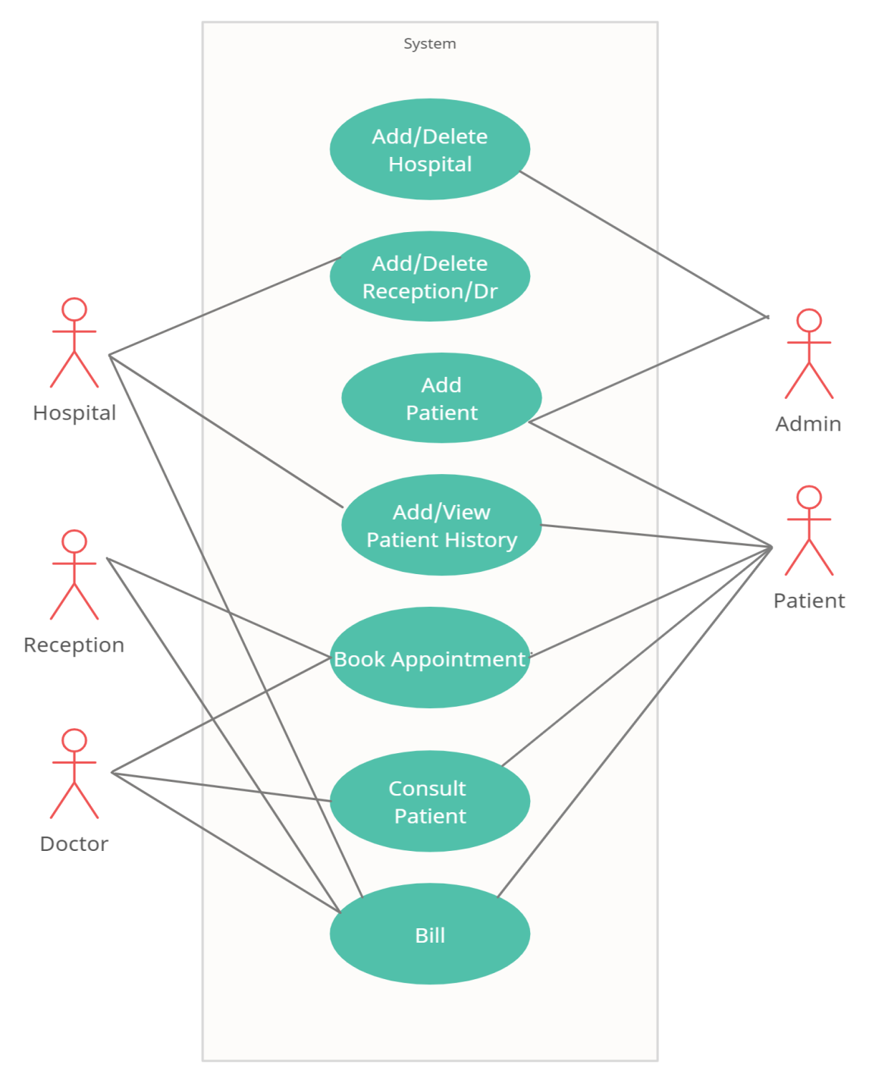
System Design
Unified Modeling Language(UML)
Use case diagrams

Slide 10
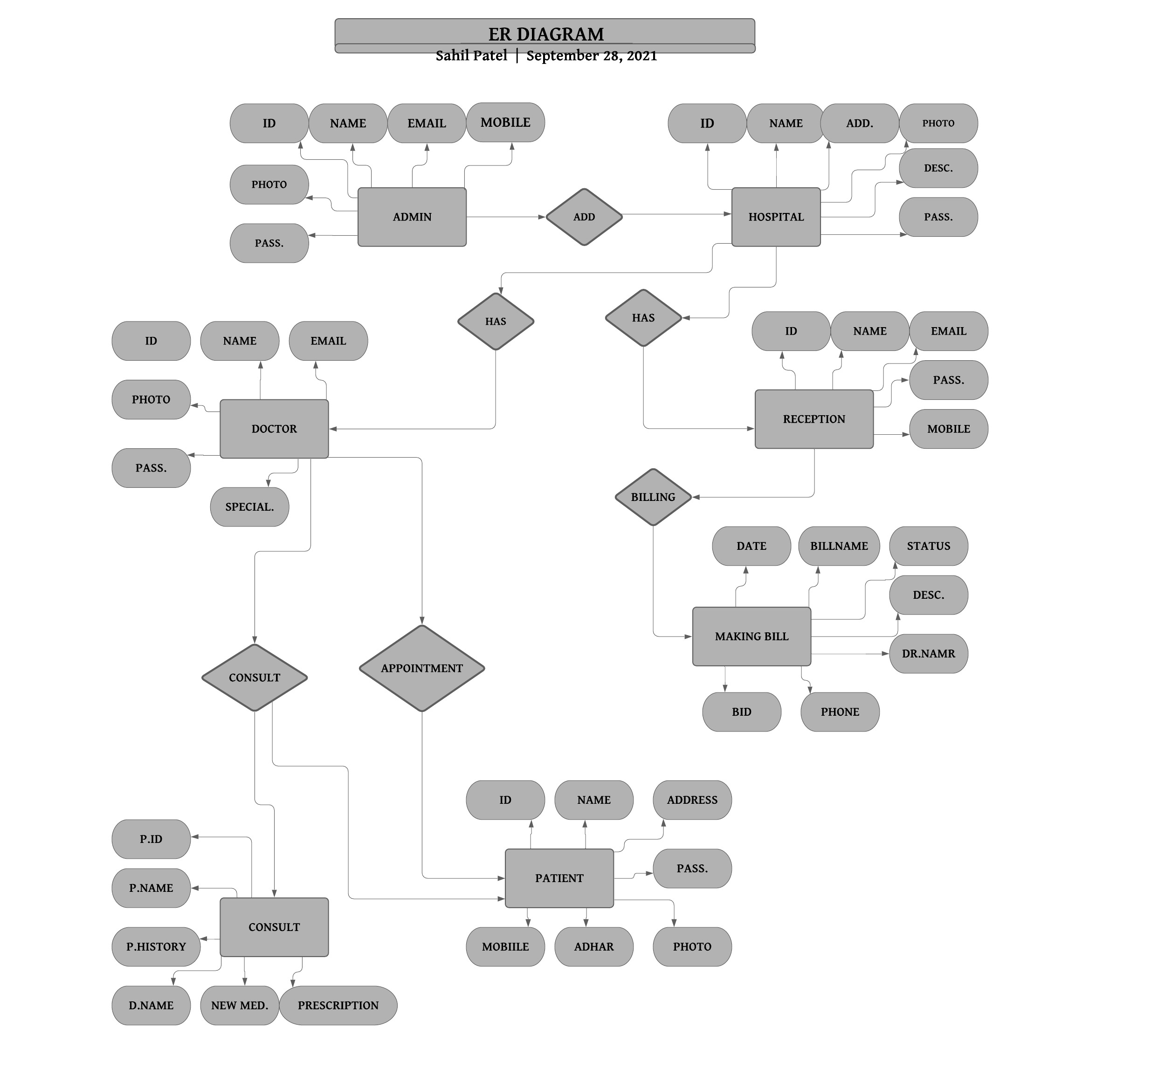
ER Diagram

Slide 11
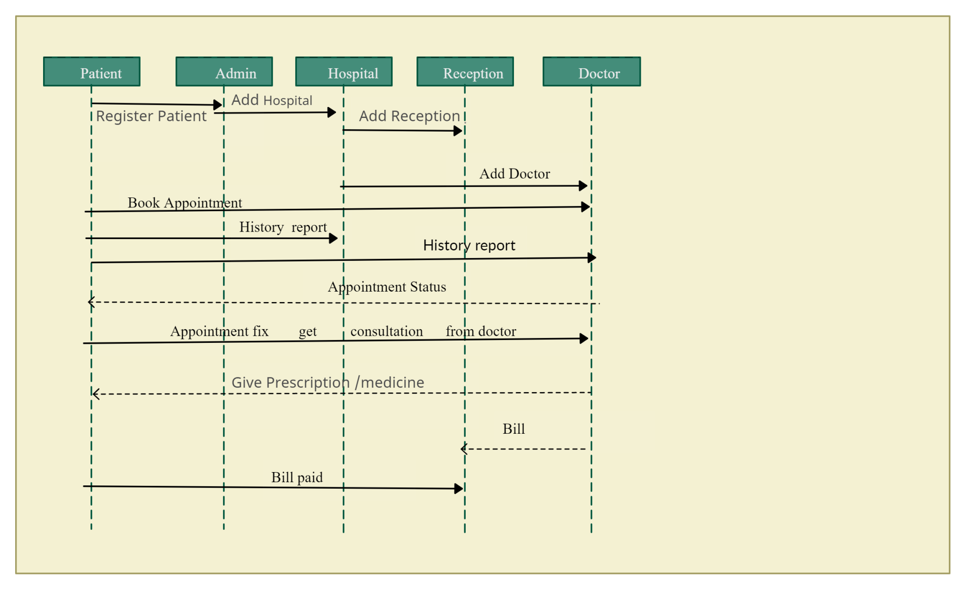
Sequence diagram

Slide 12
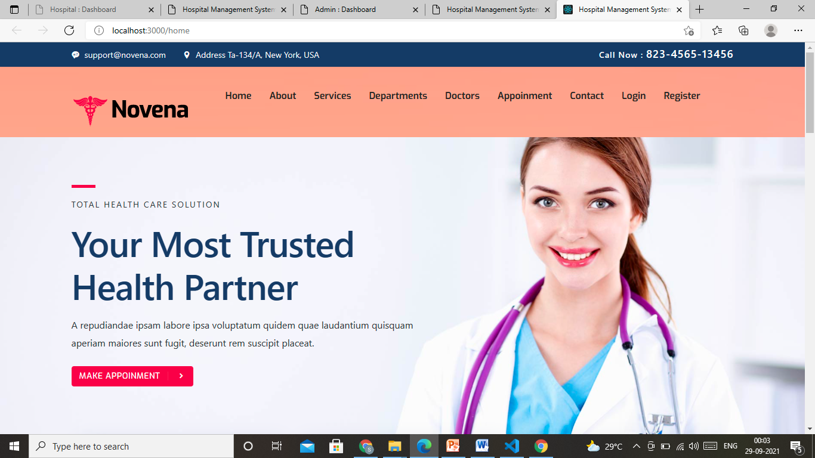
Test Screens

Slide 13
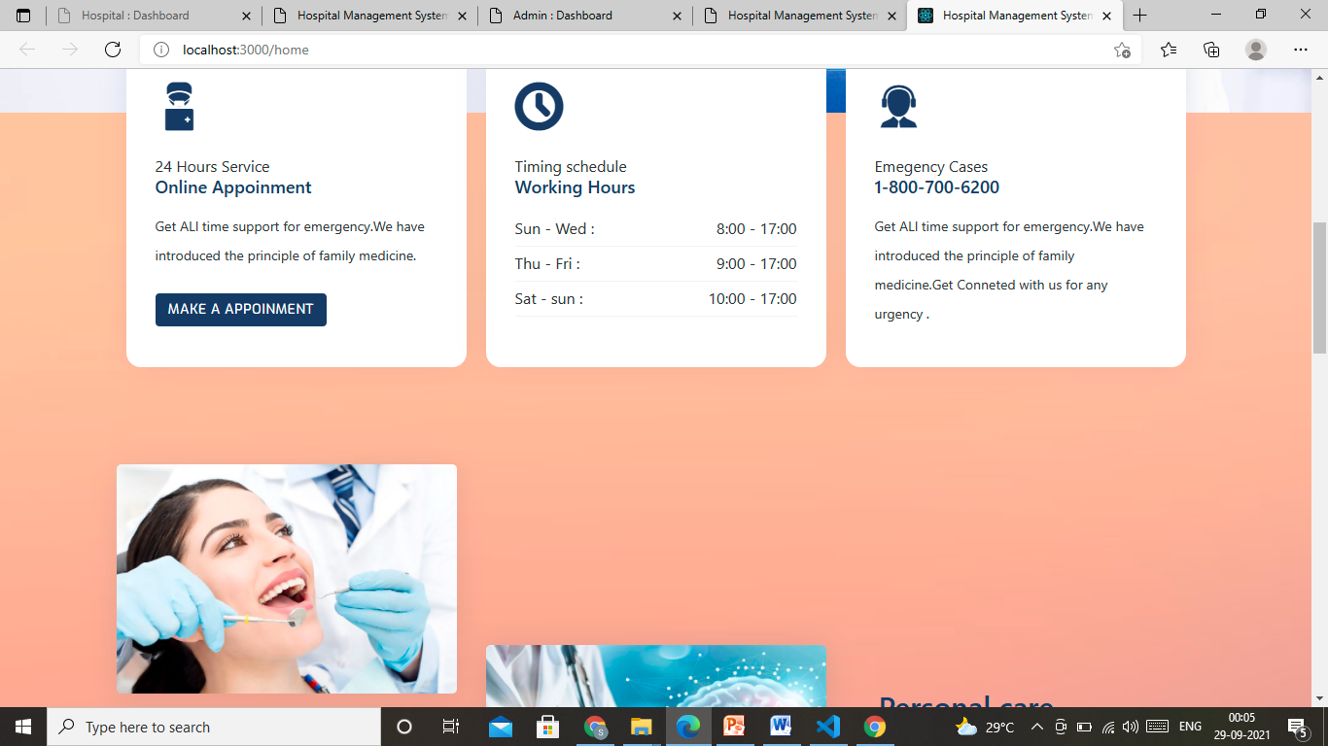

Slide 14
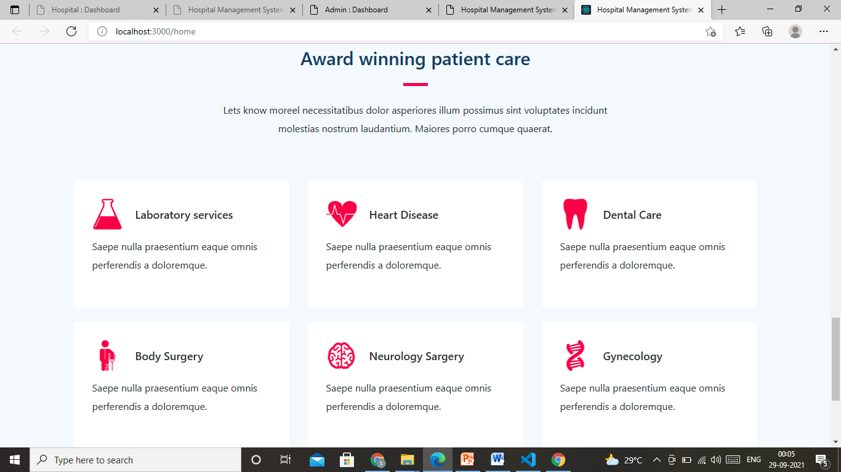

Slide 15
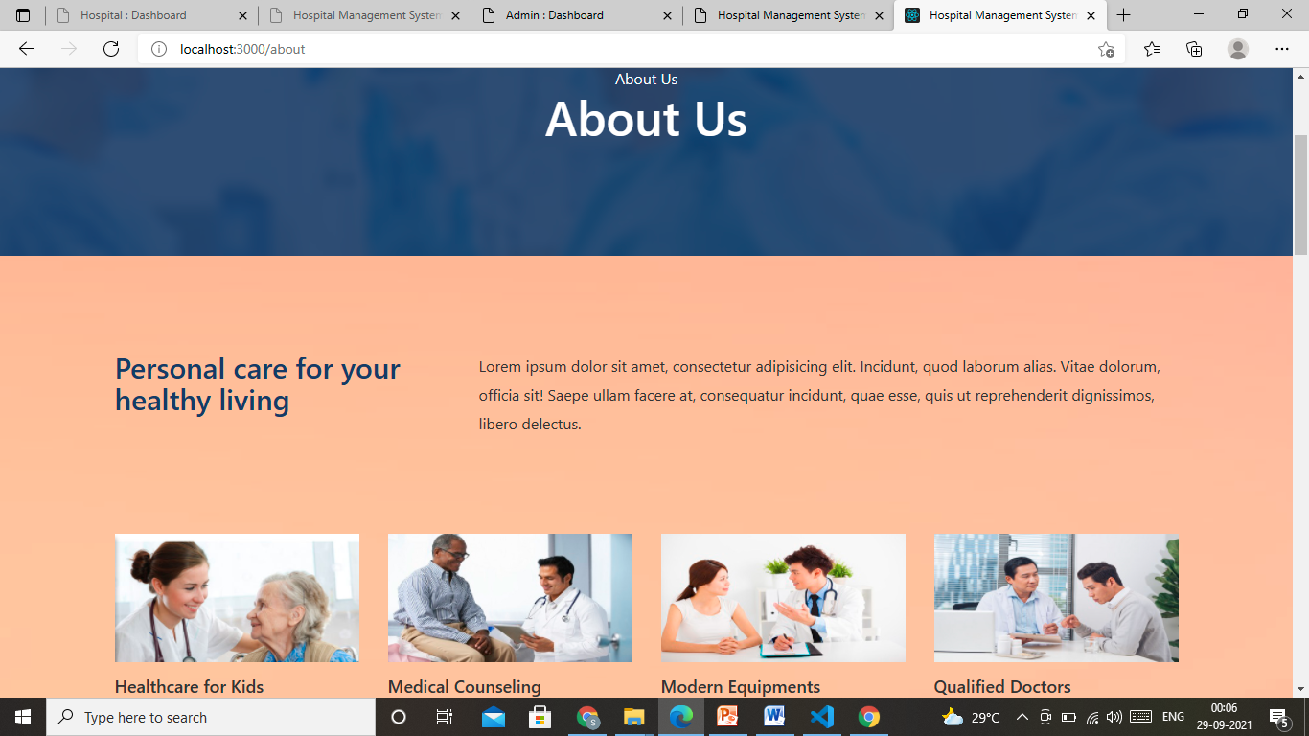
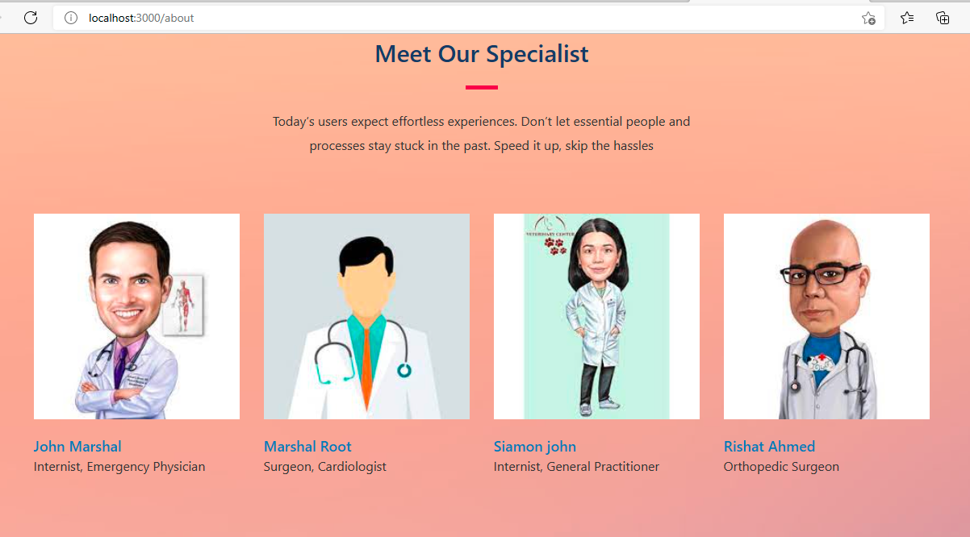

Slide 16
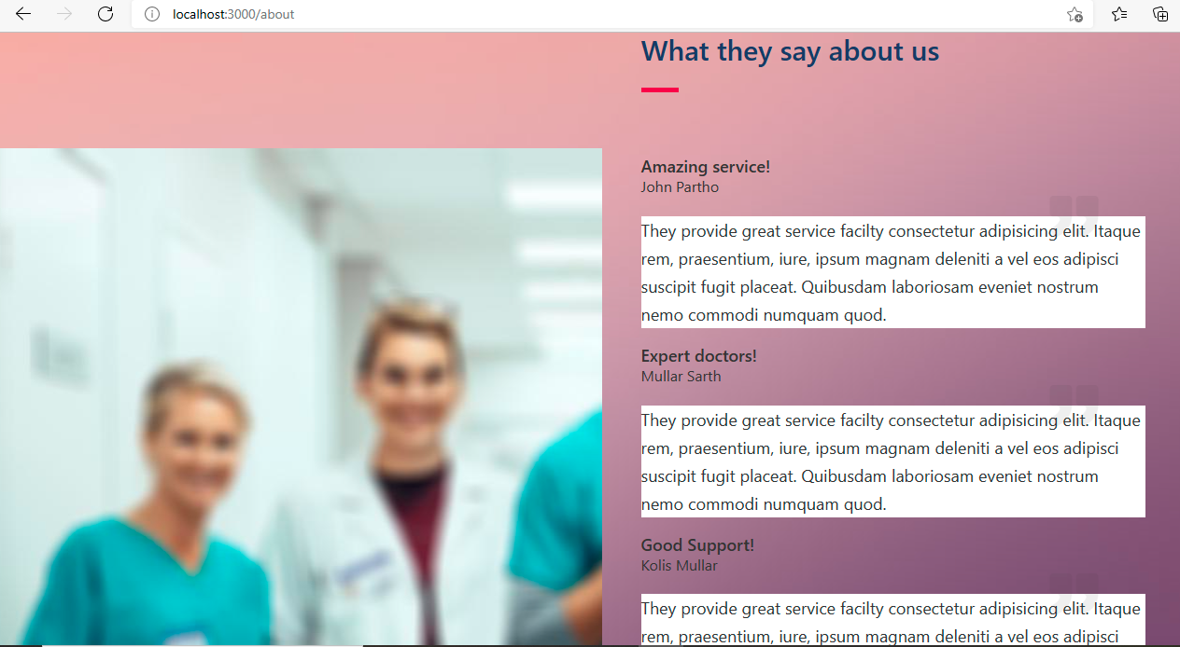
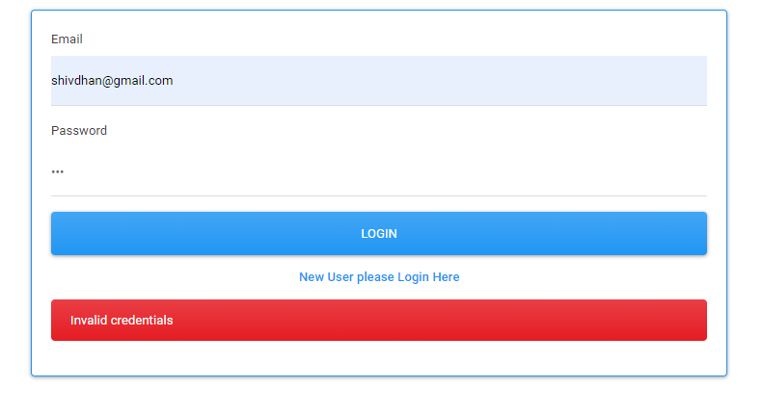

Slide 17
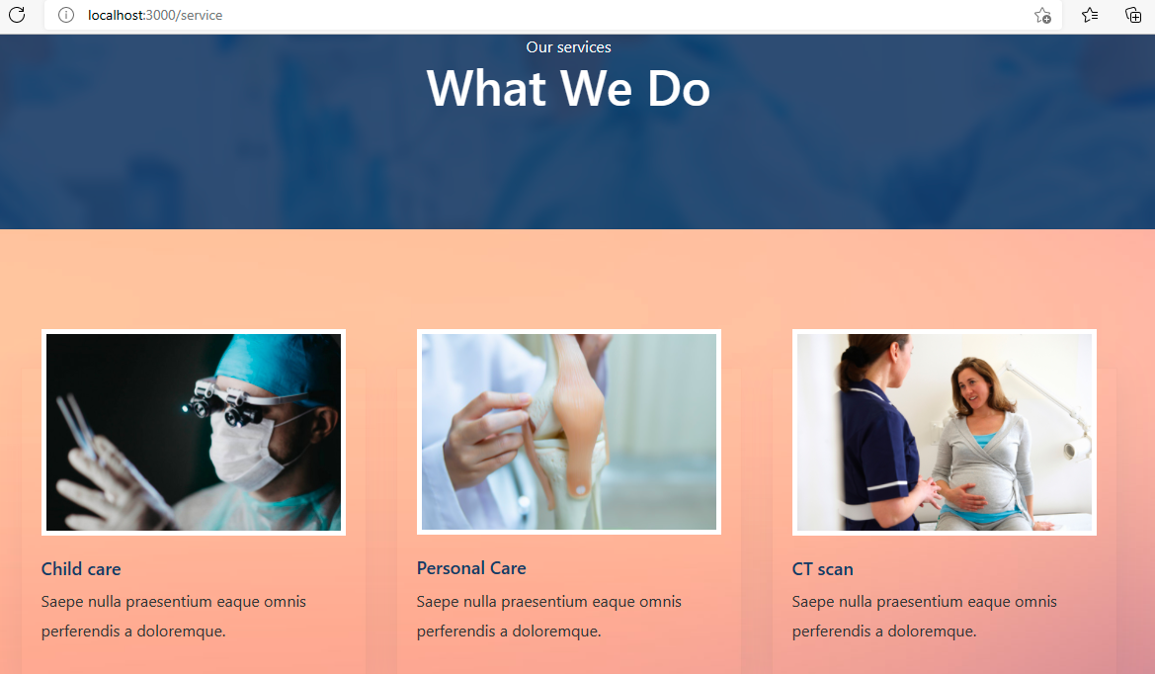

Slide 18
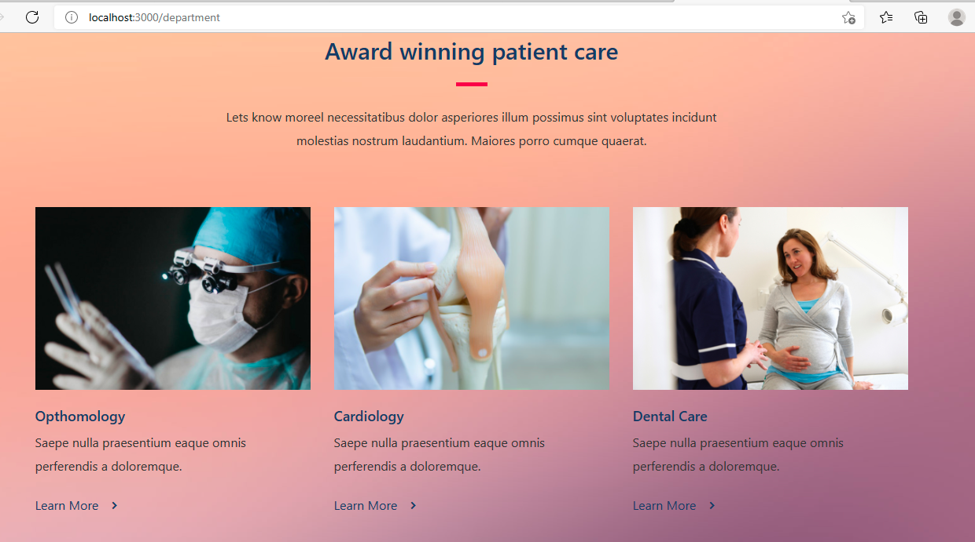
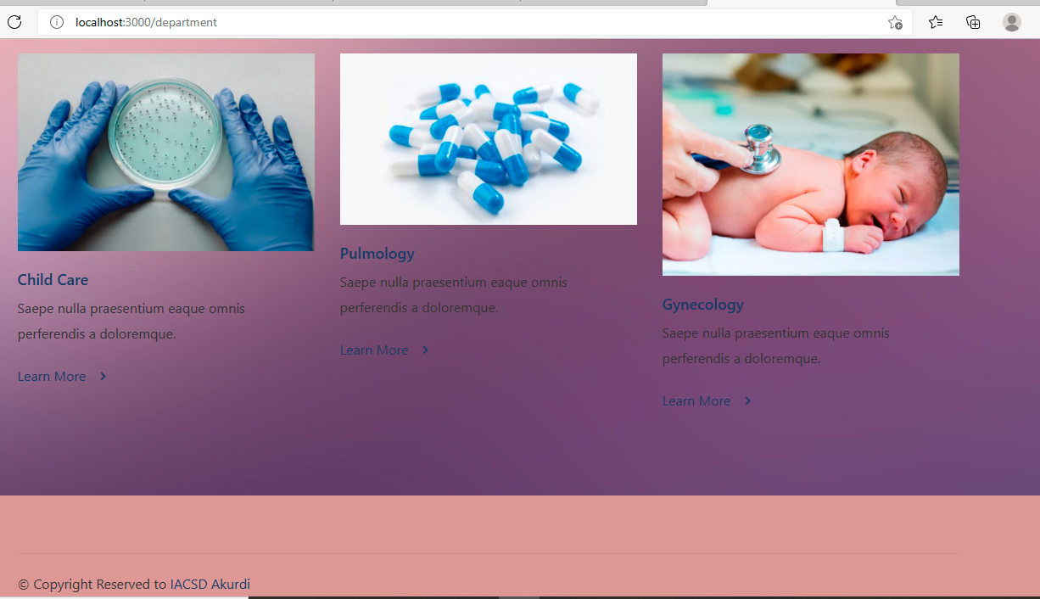

Slide 19
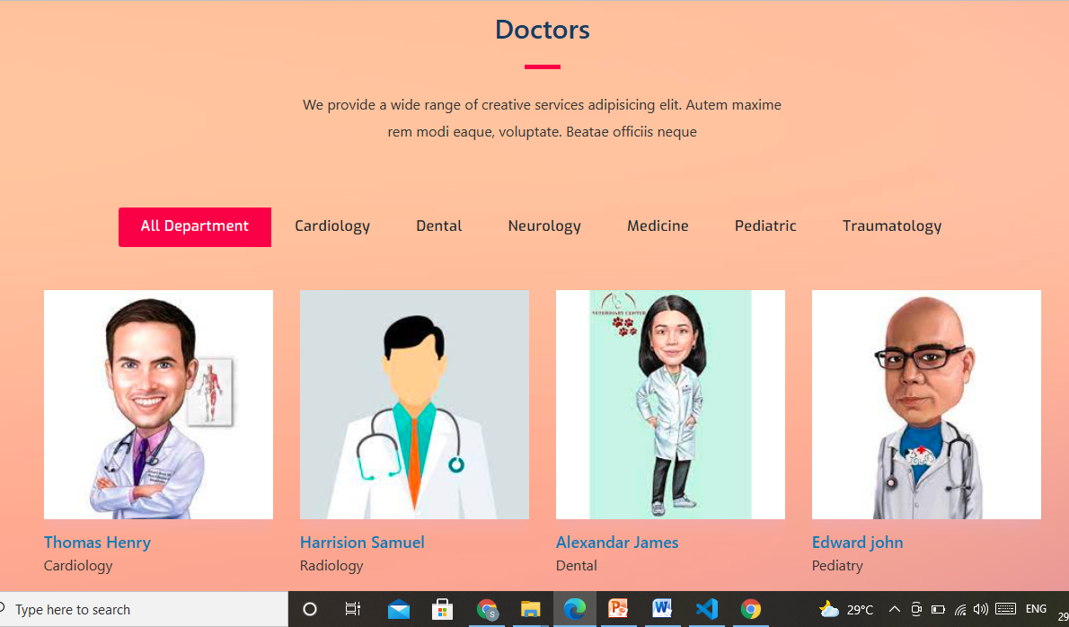

Slide 20
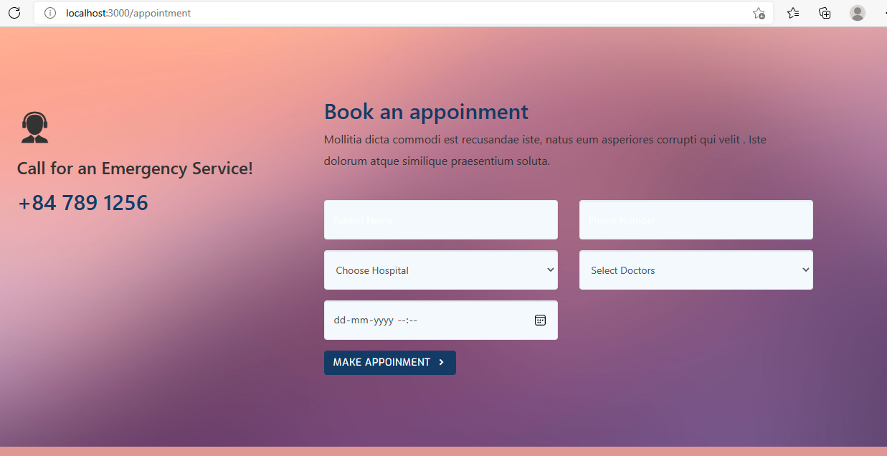

Slide 21
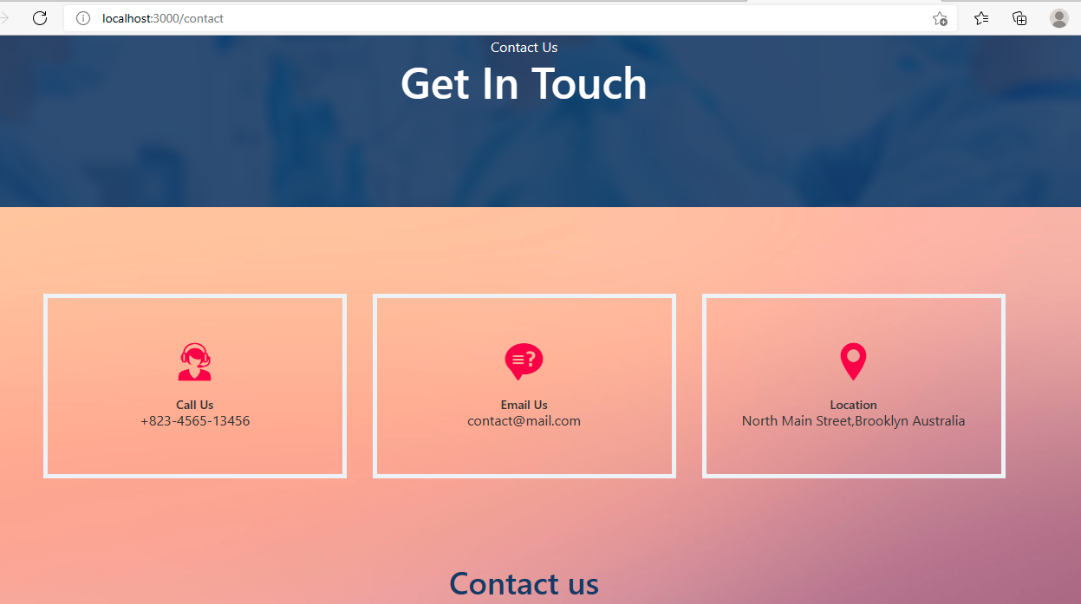

Slide 22
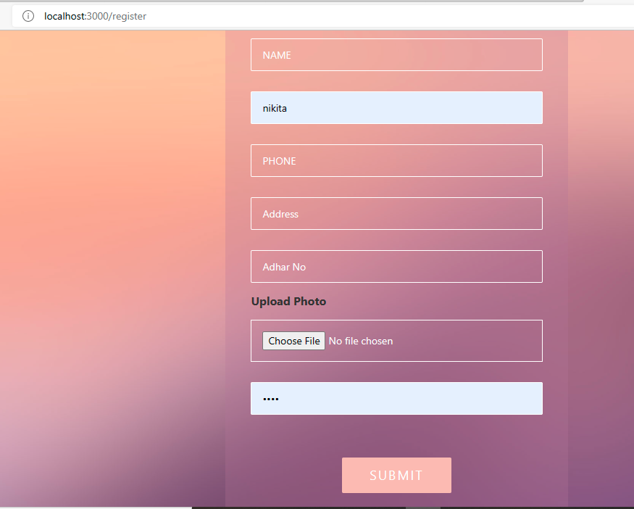

Slide 23
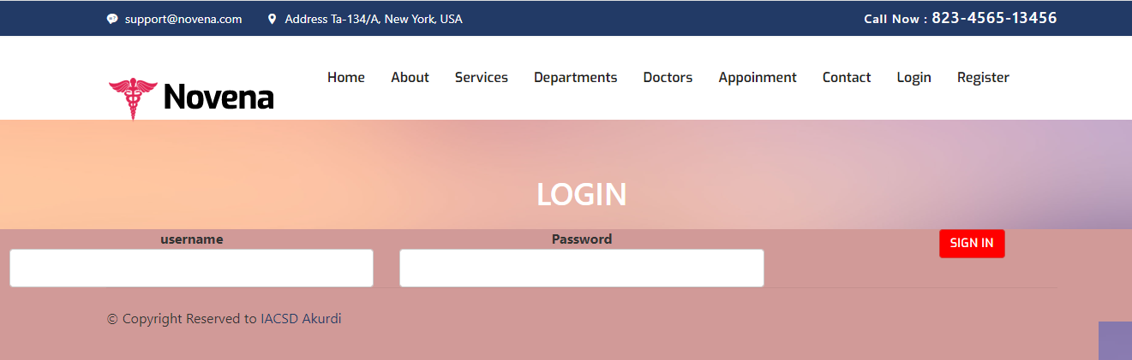
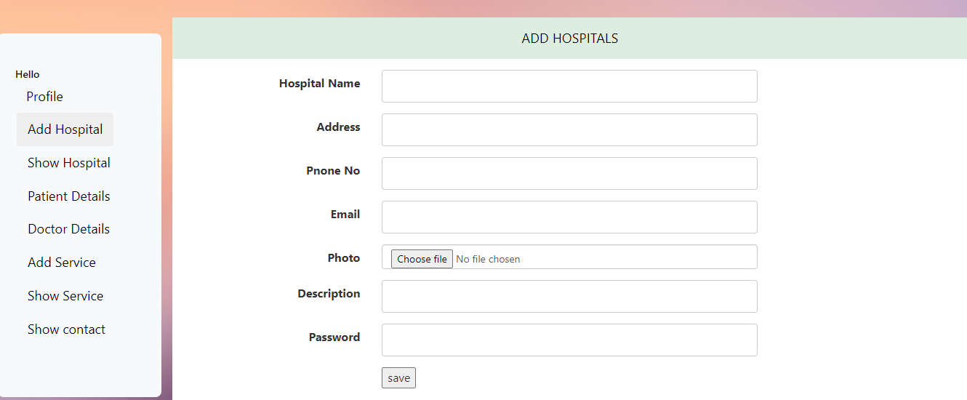

Slide 24
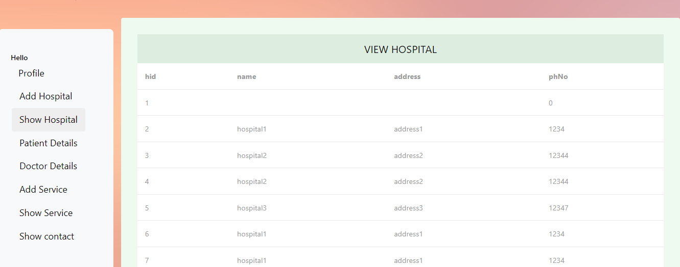
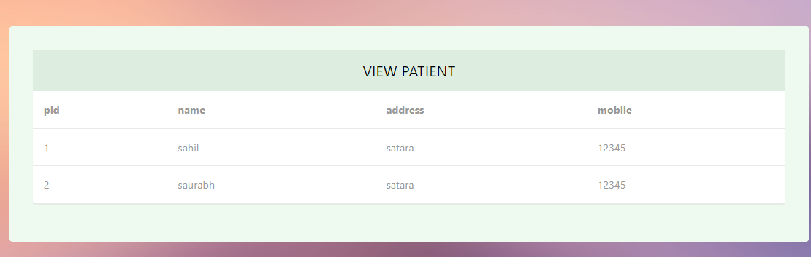

Slide 25
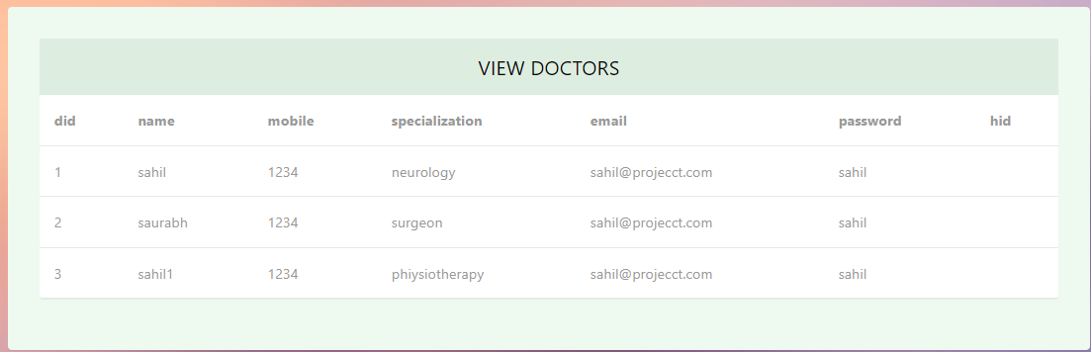

Slide 26
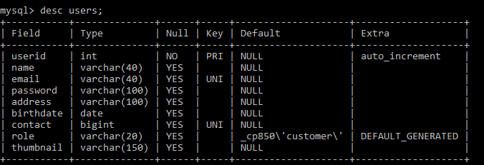
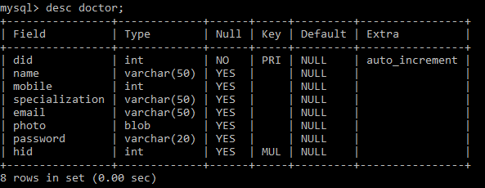

Slide 27
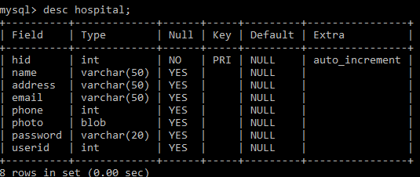
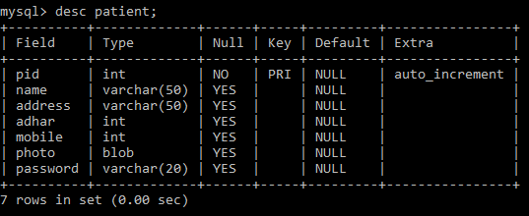

Slide 28
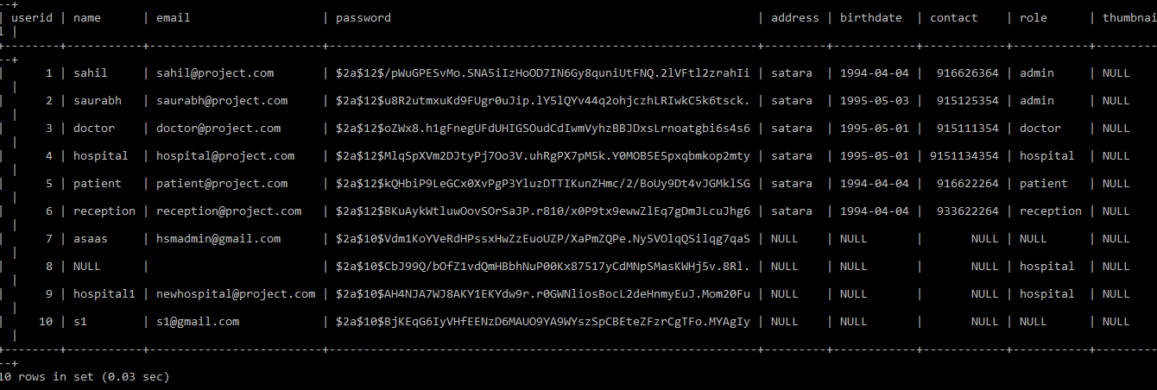
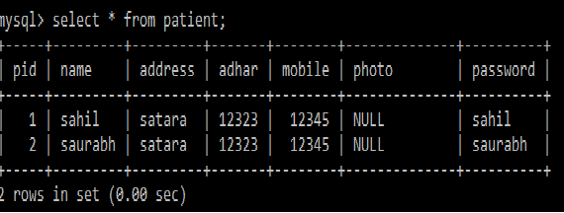

Slide 29
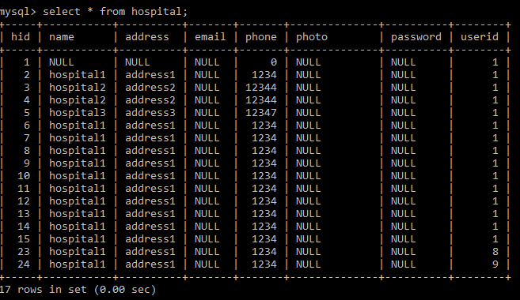

Slide 30
Conclusion And Future Scope
Conclusion
This is to conclude that the project that we undertook was worked upon with a sincere effort. Most of the requirements have been fulfilled up to the mark.
The project made here is just to ensure that this product could be valid in today real challenging world. Here all the facilities are made and tested.

Slide 31
Future Scope
Keeping challenges in mind, HMS was built from scratch to provide a solution by bringing convenience, predictability and quality together in the Indian healthcare ecosystem. HMS is unique in its approach to simplify doctor discovery and ease of booking and access.

Slide 32
References
https://getbootstrap.com/
https://spring.io/projects/spring-boot
https://reactjs.org/docs/
https://reactstrap.github.io/
https://css3generator.com/
https://help.practo.com/

